Slide 1
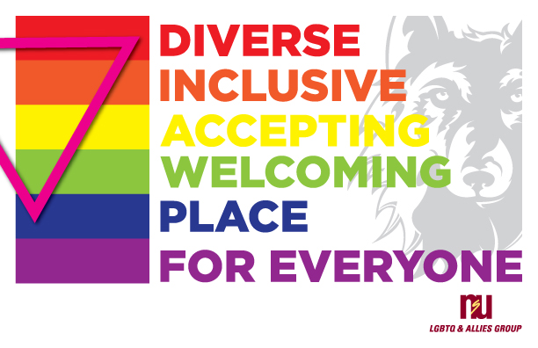
NSU LGBTQI
ALLY TRAINING
Dr. Kristi Brownfield
Assistant Professor of Sociology
Dr. Karyl Meister
Assistant Professor of Counselor Education
Dr. Courtney Waid
Associate Professor of Criminal Justice

Slide 2
Purpose & Objectives
Identify terms commonly associated with the LGBTQI community
Recognize who falls into the LGBTQI community
Recognize and utilize opportunities to be an advocate to/for the LGBTQI community

Slide 3
Terminology
LGBTQI – the entirety of the lesbian, gay, bisexual, transgender, queer/questioning, and intersex community
  Includes asexual, pansexual, demisexual, demigender, and many other “sexual” and “gender” individuals
  Often written as LGBT, LGBTQ, LGBTQIA, LGBTQQIA

Slide 4
Terminology (Cont.)
Sex – the whole of a person’s biological components, including chromosomes, hormones, and genitalia that is generally assigned at birth
  Determination is based on the external presentation of the genitalia

Slide 5
Terminology (Cont.)
Gender – the societal roles and expectations that a person is typically expected to perform based on their sex as noted at birth

Slide 6
Terminology (Cont.)
Sexual/affectional orientation – the desire to form a close relationship(s) with another human, whether primarily via a sexual relationship or an affectional relationship

Slide 7
Terminology (Cont.)
Gender identity – the way a person feels about the sex assigned at birth, both in terms of how they relate to the associated societal roles and the outward expression of their feeling related to the sex assigned at birth – may or may not take steps to change their body accordingly

Slide 8
Terminology (Cont.)
Lesbian – a woman, whether natal or otherwise, who has a sexual and/or affectional orientation toward other women

Slide 9
Terminology (Cont.)
Gay – a man, whether natal or otherwise, who has a sexual and/or affectional orientation toward other men
  This term is also often used as an umbrella term to mean the entire LGBTQI community

Slide 10
Terminology (Cont.)
Bisexual – any individual, male or female, whether natal or otherwise, who has a sexual and/or affectional orientation toward both men and women

Slide 11
Terminology (Cont.)
Transgender – used as a broad umbrella term for those individuals who do not identify as the sex they were born; also used to specifically identify a person who is in the process of transitioning their body to the body of the opposite sex, whether in part or wholly
Cisgender – denoting or relating to a person whose sense of personal and gender identity corresponds with their birth sex

Slide 12
Pronouns
Terms of address:
  She/her/hers/herself
  He/him/his/himself
  They/them/theirs/themselves
  Zie/Zim/Zir/Zieself
  Per/per/per/perself
  Xe/xem/xyr/xyrs/xemself
  Ve/ver/vis/vis/verself
  E or ey/em/eir/eirs/eirself
  (f)ae/(f)aer/(f)faers/(f)aerself

Slide 13
Terminology (Cont.)
Queer – used as a broad umbrella for the entire LGBTQI community
  A person not wishing to identify as a specific label with in the LGBTQI community
Questioning – someone who is unsure of their sexual orientation or gender identity and is attempting to decide where they fit and which label (if any) applies to them

Slide 14
Terminology (Cont.)
Intersex – a medical condition whereby there are differences in the genitalia, chromosomes, hormones or other medical factors that impact sex development in utero

Slide 15
Terminology (Cont.)
Asexual – a person who has very little or no desire to engage in any sexual or affectional orientation; aka Ace
Agender – a person who has very little to no desire to identify as male, female, masculine, feminine, or any other gender identity

Slide 16
Terminology (Cont.)
Power – the ability to make others do what you want them to do regardless of resistance others pose
Privilege – unasked for or unearned benefits due to membership in a social group

Slide 17
The LGBTQI Community
4.5% of the US population identifies as LGBT (Newport, 2018)
  3.9% male
  5.1% female
  4% White, 5% black, 6.1% Latinx, 4.9% Asian
  Largely Millennials (increased from 5.2% to 8.1% from 2011 to 2017)
    Older LGBTQI individuals not as likely to be out

Slide 18
The LGBTQI Community (Cont.)
South Dakota Statistics (Movement Advancement Project [MAP], 2019)
  13,043 LGBTQI identified individuals
    2% of SD population
  21.1% of those are same-sex couples raising children

Slide 19
Allies In and Out of the Classroom
Explore your own biases, values, and blind spots
Requires commitment
Requires patience with self and others
Reactions to discrimination and bias speak as loudly, if not louder, than words
Be mindful of existing workforce policies and procedures; advocate for inclusive policies

Slide 20
Challenges in Management
Bathroom usage
Harassment, misgendering
Sexual harassment
Inefficient compliance with new laws and regulation practices
Technology challenges – “revenge porn”
“Partner “vs. “Spouse”
Closetedness/Heteronormativity
Intersectionality

Slide 21
Queer in the Time of COVID

Slide 22
Legal Implications
Supreme Court decision on whether Title VII of the Civil Rights Act include sexual orientation and gender identity
  Does sex include sexual orientation and gender identity?
  21 States, Guam & Puerto Rico have laws protecting sex and gender identity in some form

Slide 23
FMLA and LGBTQI
Family medical leave allowance is now available for all legally married same-sex partners
Covers adoption leave in states where same-sex adoption is available
Covers leave for married partner’s deployment/military circumstances

Slide 24
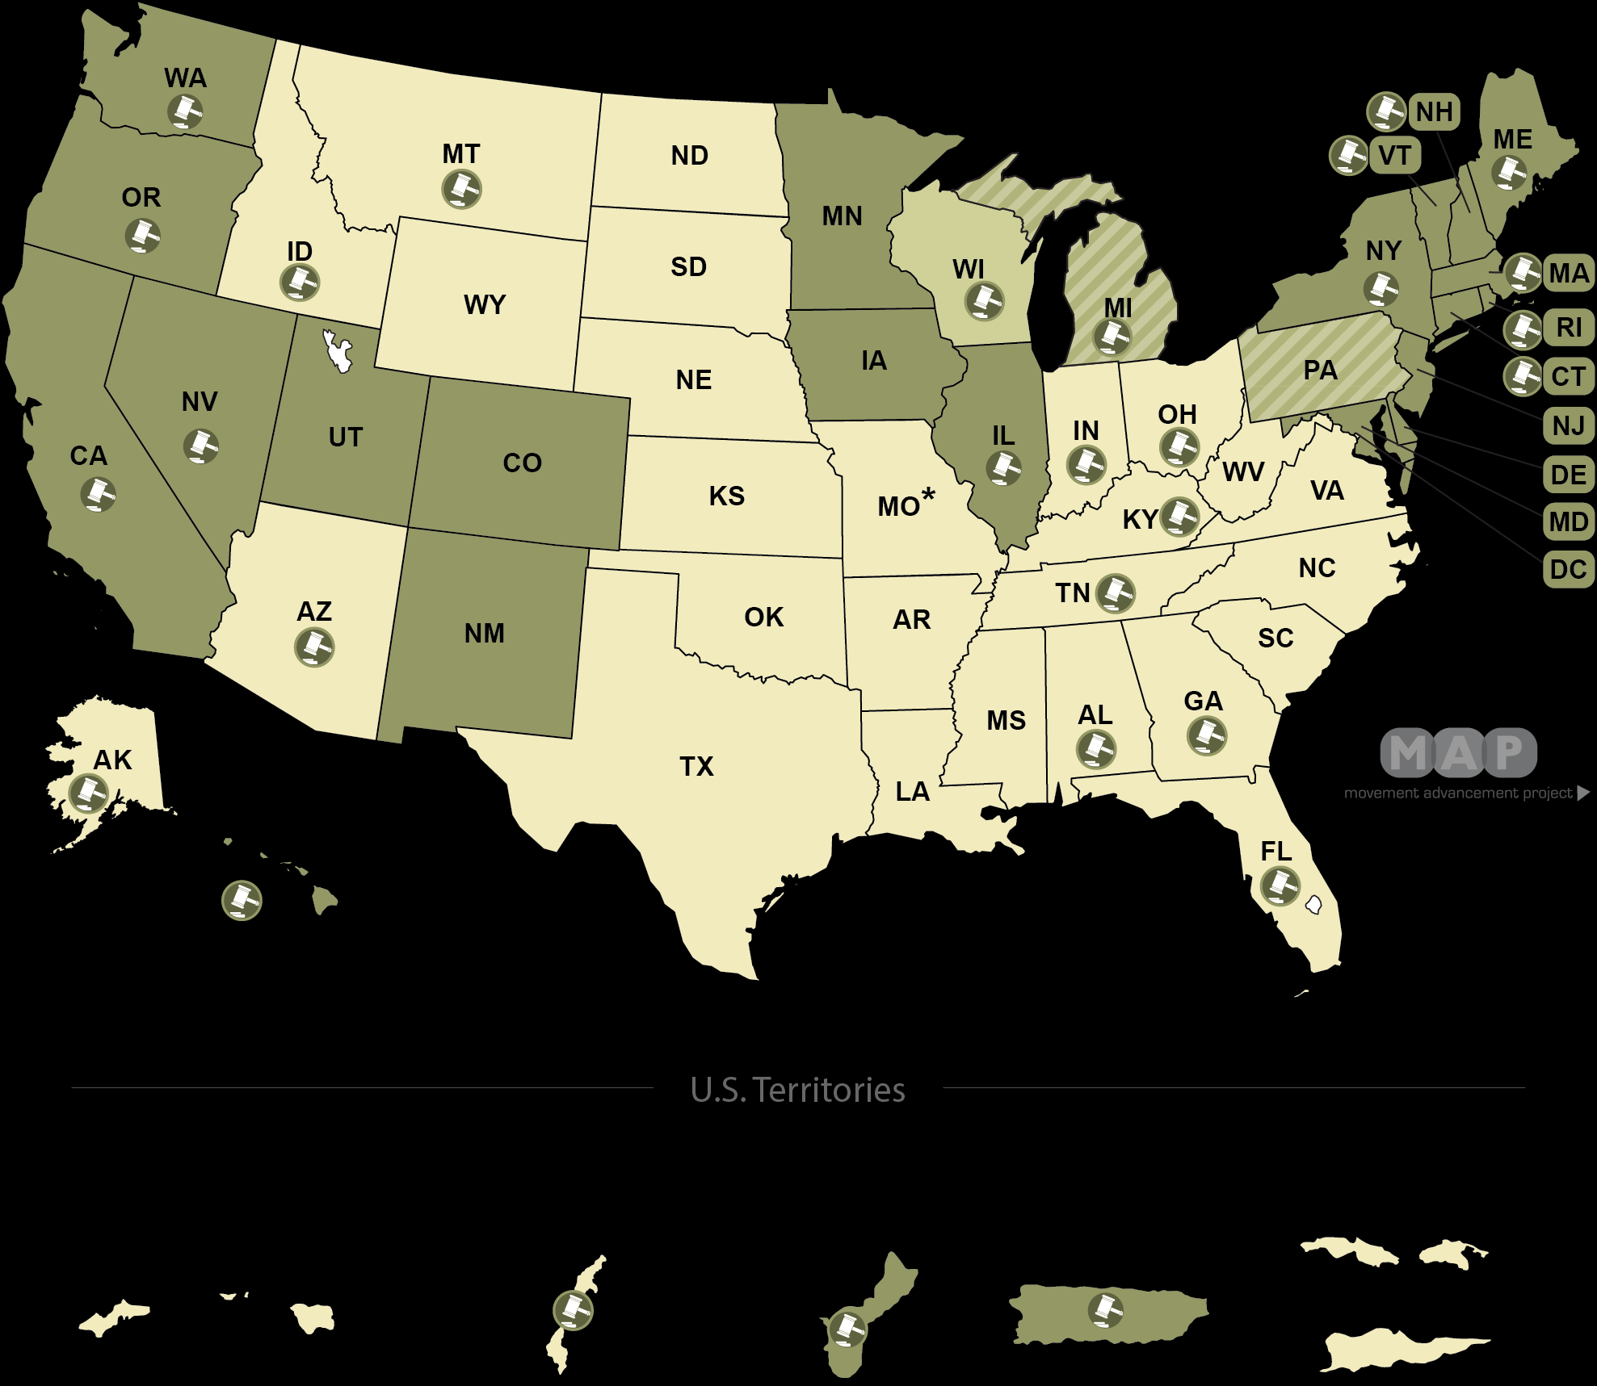

Slide 25
Global Employment
https://www.equaldex.com/

Slide 26
References
Newport, F. (2018) In U.S., Estimate of LGBT population rises to 4.5%. Retrieved from https://news.gallup.com/poll/234863/estimate-lgbt-population-rises.aspx
Brown, A. (2017). 5 Key findings about LGBT Americans. Retrieved from http://www.pewresearch.org/fact-tank/2017/06/13/5-key-findings-about-lgbt-americans/
Movement Advancement Project (2019). South Dakota’s Equality Profile. Retrieved from http://www.lgbtmap.org/equality_maps/
profile_state/SD

