Slide 1
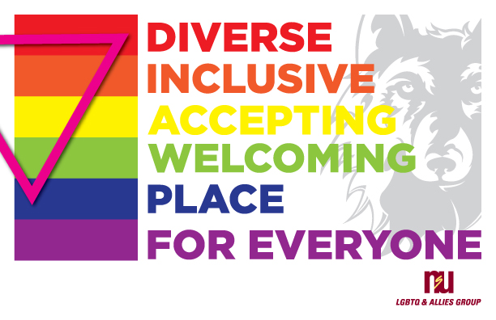
NSU LGBTQI
ALLY TRAINING
Dr. Kristi Brownfield
Assistant Professor of Sociology
Dr. Karyl Meister
Assistant Professor of Counselor Education
Dr. Courtney Waid
Associate Professor of Criminal Justice

Slide 2
Purpose & Objectives
Identify terms commonly associated with the LGBTQI community
Recognize who falls into the LGBTQI community
Recognize and utilize opportunities to be an advocate to/for the LGBTQI community

Slide 3
Understanding Our Role
See handout of terms
Understanding the power and privilege of ourselves and our students
  Power – the ability to make others do what you want them to do regardless of resistance others pose
  Privilege – unasked for or unearned benefits due to membership in a social group

Slide 4
The LGBTQI Community
4.5% of the US population identifies as LGBTQI (Newport, 2018)
  3.9% male
  5.1% female
  4% White, 5% black, 6.1% Latinx, 4.9% Asian
  Largely Millennials (increased from 5.2% to 8.1% from 2011 to 2017)
    Older LGBTQI individuals not as likely to be out

Slide 5
The LGBTQI Community (Cont.)
South Dakota Statistics (Movement Advancement Project [MAP], 2019)
  13,043 LGBTQI identified individuals
    2% of SD population
  21.1% of those are same-sex couples raising children

Slide 6
Allies In and Out of the Classroom
Explore your own biases, values, and blind spots
  Requires commitment
  Requires patience with self and others
Reactions to discrimination and bias speak as loudly, if not louder, than words
Be mindful of existing workforce policies and procedures; advocate for inclusive policies

Slide 7
Challenges on Campus
Bathroom usage
Harassment, misgendering
Sexual harassment
Inefficient compliance with new laws and regulation practices
Technology challenges – “revenge porn”
“Partner “vs. “Spouse”
Closetedness/Heteronormativity
Intersectionality

Slide 8
Queerantine
Higher unemployment, depression, homelessness
Less medical care
  Health care discrimination
Increased risk of domestic violence
Loss of safe and affirming spaces
  College campus
  Community resources
  Virtual events

Slide 9
Legal Implications
Discrimination in Employment
  June 15, 2020 – In a 6-3 decision, Title VII does protect LGBTQI people from being fired due to sexual orientation and gender identity
  Those with religious objections may be able to refrain from hiring LGBTQI people under the Religious Freedom Restoration Act
Housing discrimination of LGBTQI people is still allowed under federal law

Slide 10
FMLA and LGBTQI
Family medical leave allowance is now available for all legally married same-sex partners
Covers adoption leave in states where same-sex adoption is available
Covers leave for married partner’s deployment/military circumstances

Slide 11
References
Newport, F. (2018) In U.S., Estimate of LGBT population rises to 4.5%. Retrieved from https://news.gallup.com/poll/234863/estimate-lgbt-population-rises.aspx
Brown, A. (2017). 5 Key findings about LGBT Americans. Retrieved from http://www.pewresearch.org/fact-tank/2017/06/13/5-key-findings-about-lgbt-americans/
Movement Advancement Project (2019). South Dakota’s Equality Profile. Retrieved from http://www.lgbtmap.org/equality_maps/profile_state/SD

