Slide 1
Television’s Representations of Modern-Day Crime Fighters: The Function of Autism Spectrum Disorder (ASD)
Kristi Brownfield
Courtney Waid-Lindberg
Northern State University

Slide 2
Classical Representations of Disability
Savant
Isolation and pathology
Self-sacrifice
Asexuality and dependence
Violence

Slide 3
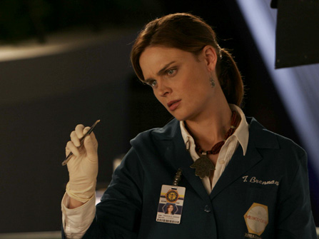
Bones (2005-2017)
Dr. Temperance Brennan (series regular) and Dr. Zack Addy (series regular, reoccurring)
Features forensic anthropologist Dr. Temperance Brennan (“Bones”) of the Jeffersonian and her FBI partner Seeley Booth as they and Dr. Brennan’s team of “squints” work together to solve crimes
Seasons 1-2, 46 episodes
Notes:
Picture is from season 1, episode 7 “A Man on Death Row”

Slide 4
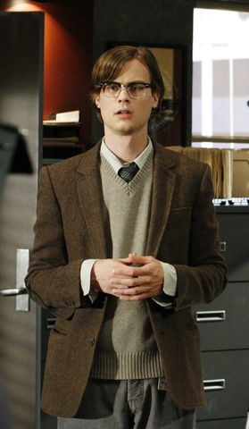
Criminal Minds (2005-present)
Dr. Spencer Reid (series regular)
Features the work of the FBI’s Behavioral Analysis Unit (BAU) as they provide investigative and case support to local, state, federal, and international policing agencies
Seasons 1-2, 45 episodes

Slide 5
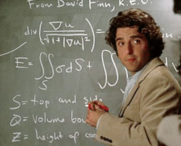
Numb3rs (2005-2010)
Dr. Charlie Epps
Features the collaboration of mathematician Dr. Charlie Epps and his brother, FBI agent Don Epps, as they use math to assist in solving crimes
Seasons 1-2, 37 episodes

Slide 6

Scorpion (2014-present)
Members of “Scorpion”
  Walter O’Brien
  Dr. Tobias (“Toby”) Meriweather
  Happy Quinn
  Sylvester Dodd
Show is loosely based on Walter O’Brien, CEO of Scorpion Computer Services and features the work of “super geniuses” as they solve crimes and other episodic problems
Seasons 1-2, 46 episodes

Slide 7
“I don’t know what that means.”
Divergence is highlighted and often made fun of
  Emphasis on normalization
  Minimize autistic traits in the majority of interactions
  Character arcs emphasize connecting with people as the path to normalization
    Particularly romantic connections

Slide 8
Breaking Boundaries
Character boundaries are rarely respected
  Walter O’Brien & Temperance Brennan
  Charlie Epps & Spencer Reid
Instances are often shown to be a “lesson” or “growth” on the part of the character

Slide 9
“Human Calculator”
Characters are often treated as tools or obscure devices
  Sylvester Dodd
Professional respect is rarely given to characters despite being successful and at the top of their fields
  Charlie Epps vs. Temperance Brennan

Slide 10
Re-Imagined Archetypes
All three themes present in the sample are adaptions of the “savant” trope
  Full active lives rather than simply being MacGuffins
  Character with ASD is still largely treated within the narrative as a tool used to effective solve crime so long as the tools are “managed” by “normal” people until they are normalized
  This narrative thread is often supported by the reluctance of other characters to interact with the ASD-characters outside of the crime solving context early-on within the series
Outside experts utilized by the institution but are, largely, not part of the institution

Slide 11
Re-Imagined Archetypes
Still presented as naïve characters that are largely disconnected from society
  Can be fixed specifically through “proper” socialization
    Largely shown as a successful strategy
Fear of becoming violent
  “That could be me”
  Mostly present within the villain of the week

Slide 12
Looking Forward
Expand sample
  Informal structures, canonical representations (e.g., Maxwell and King)
Audience reception
  How do the audiences view, react, or transform these characters?
  Questions of representation (e.g., the “Dumbledore” debate)
Reflections of the treatment of persons with disability by police
  Reflections of larger attitudinal barriers felt by people with disabilities
Other intersections

