Slide 1
Thinking about Assessment in a programmatic way
GPSA, October 2017
Cindy Aamlid, SMSU
Kristi Brownfield, Northern State
Courtney Waid-Lindberg, Northern State

Slide 2
Today’s Agenda
Moving through the steps of the assessment cycle: in theory and in practice
  Rework and refine student learning outcomes
  Moving from grading course assignments to assessing student learning
  Using the results for program review

Slide 3
Funny exam answers
http://www.youtube.com/watch?v=swXDy4xoD8M&list=PL65A351C802E912A3&index=1&feature=plpp_video

Slide 4
Backwards Design
Identify Desired Results
  What content knowledge and skills should the students have when they finish our program? What do we want to prioritize given our resources and our typical student goals? What established standards or requirements are there based on various higher education connected agencies?
Determine Assessment Evidence
  How will we know if students have achieved the desired results? What benchmarks along the way can we set? How can we evaluate our goals in fair (to both students AND faculty) and consistent ways?
Plan Learning Experiences and Instruction
  In which classes will students learn knowledge and skills? Will we treat systemic learning holistically or specifically? How do we scaffold learning in the program?

Slide 5
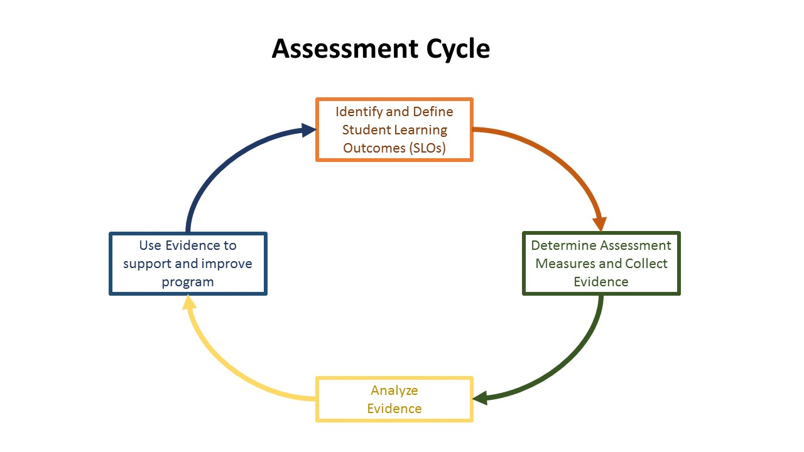
Adopted by SMSU

Slide 6
What do we really want to know…desired results for program
The Sociological Perspective (Essential Concepts) | The Sociological Toolbox (Essential Competencies)
The Sociological Eye: Sociology as a distinctive discipline | Apply Sociological Theories to Understand Social Phenomena (Theory)
Social Structure: The impact of social structures on human action | Critically Evaluate Explanations of Human Behavior and Social Phenomena (Evaluation)
Socialization: The relationship between the self and society | Apply Scientific Principles to Understand the Social World (Sociology as a Science)
Stratification: The patterns and effects of social inequality | Evaluate the Quality of Social Scientific Methods and Data (Methodological Practice)
Social Change and Social Reproduction: How social phenomena replicate and change | Rigorously Analyze Social Scientific Data (Quantitative and Qualitative Data Literacy)
 | Use Sociological Knowledge to Inform Policy Debates and Promote Public Understanding (Public Skills and Citizenship)

Slide 7
Assessment Level 1:
Student learning outcomes (slo)
Who needs to know What, for What?
Use action verbs, be student centered, and measurable
  “Students will be able to apply gender stratification to their own lives”
  “This program exposes students to gender stratification”
Think about SLOs in terms of various levels of generality
  Institutional level: Students will communicate effectively in writing to a wide variety of audiences.
  Department/College level: Students who complete the sociology major will communicate effectively to professional and lay audiences regarding social issues
  Course level: In the Sociology Capstone course, students conduct their own research and provide evidence-based grant proposals for local organizations

Slide 8
Assessment Level 1:
SLOs vs. Goals
Students will be able to communicate effectively in a wide variety of contexts.
  Demonstrate the ability to communicate verbally and through writing sociological knowledge to audiences in the following contexts: the public, business, political, and scientific realms
  Apply and use effectively the disciplinary conventions for writing and citation
Students will be able to identify and apply sociological concepts and theories to everyday life, human behavior, and societies.
  Understandable to non-sociologists? Institutional memory?

Slide 9
Assessment Level 2
Determine Assessment measures and collect evidence
Moving from grading to assessment
SOCI 211 Marriage and Family
  Liberal Education Program SLO = Diversity
  Program SLOs = Diversity
YES, we cover all the objectives throughout the course
How do I prove that the students in this course have met the Diversity goal?
Embedded Assignment: Interviews with International Students

Slide 10
Grading Vs Assessment
Grading
Focuses on an individual student
Criteria may differ from assessment criteria…
  Sentence structure
  Presentation skills
  Late assignment penalty
Assessment
Focuses on entire cohort of students
Criteria may differ from grading criteria
What are students learning
What strategy is best for this purpose

Slide 11
Strategy and Instrument
AAC&U VALUE Rubric: Intercultural Knowledge
Criteria of Rubric Rubric Scores
Cultural self-awareness 4 = Capstone
Knowledge of cultural worldviews 3 = Milestone
Empathy skills 2 = Milestone
Verbal and nonverbal communication skills 1 = Benchmark
Attitude of curiosity 0 = Does not meet benchmark
Attitude of openness
https://manoa.hawaii.edu/assessment/resources/rubrics/InterculturalKnowledge_value.pdf

Slide 12
Rework assignment
“Learning about cultural differences from our international students”
RUBRIC CRITERIA
Cultural self-awareness
Curiosity
RESPONSE QUESTIONS
How are the student’s views on marriage, dating, etc., different or similar to your own? Provide examples and a possible explanation.
Why is knowing about culture important? What else would you like to know about this culture in relation to marriage and family? How could you go about learning that?

Slide 13
Results: mean score by criteria (score of 0-4)
Self-awareness | 3.1
Cultural worldview | 2.6
Empathy | 3.0
Communication | 3.0
Curiosity | 3.0
Openness | 2.9

Slide 14
Assessment Level 3:
Analyze evidence
Reporting out requirements will vary depending on institution

Slide 15
Assessment Level 4:
Documentation of continuous improvement
Program review
  Assessment should not be viewed as separate from program review
  Program review process can allow for a broad, multi-year analysis of assessment data
    The big picture can be viewed, and clarity for moving forward can be established
Key questions to address:
  How does your program’s assessment plan fit into your university’s strategic plan?
  How is your program review going to best serve your program?
External reviewer:
  Explain and clarify assessment goals and process

Slide 16

Big take-away

